Slide 1
Residential dataset

Slide 2
Dataset quality
Region | Buildings Sampled | False Positive Rate
Africa | 5,000 | 1.1%
Caribbean | 3,000 | 1.8%
Central Asia | 3,000 | 2.2%
Europe | 5,000 | 1.4%
Mexico | 2,000 | 0.1%
Middle East | 7,000 | 1.8%
South America | 5,000 | 1.7%
South Asia | 7,000 | 1.4%
Region | Precision | Recall
Africa | 94.4% | 70.9%
Caribbean | 92.2% | 76.8%
Central Asia | 97.17% | 79.47%
Europe | 94.3% | 85.9%
Middle East | 95.7% | 85.4%
South America | 95.4% | 78.0%
South Asia | 94.8% | 76.7%
Predict as house and it is house
Correctly predicted house area/All house area
Predict as house but it is not house
Overall: the dataset might under estimate the residential areas

Slide 3
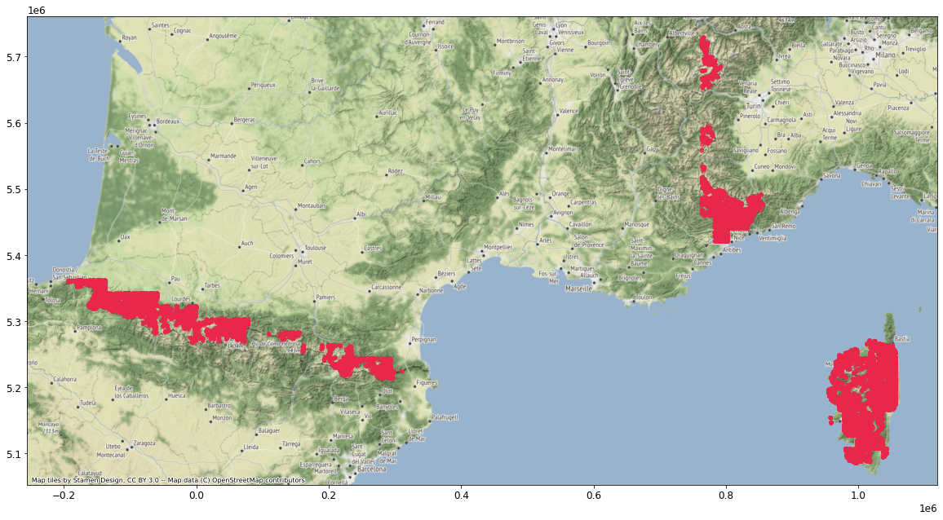
Residential data in France
345,081 houses
The house locations are weird, dataset is not complete

Slide 4
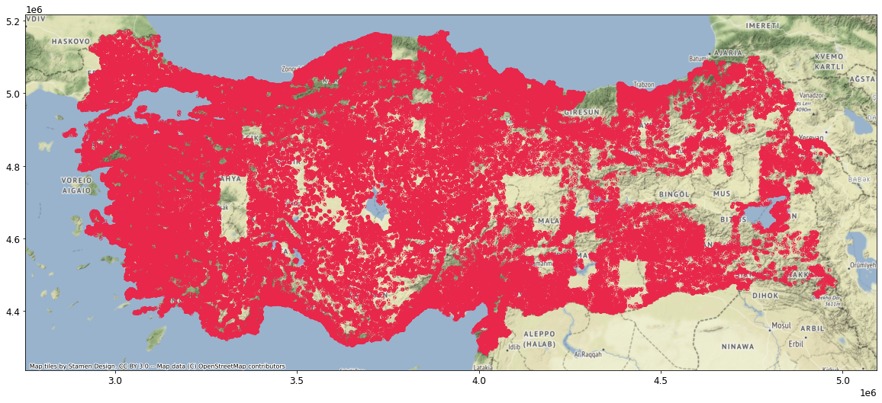
Residential data in Turkey
18,064,082 houses in total
Plotting for 1.5% of the houses

Slide 5
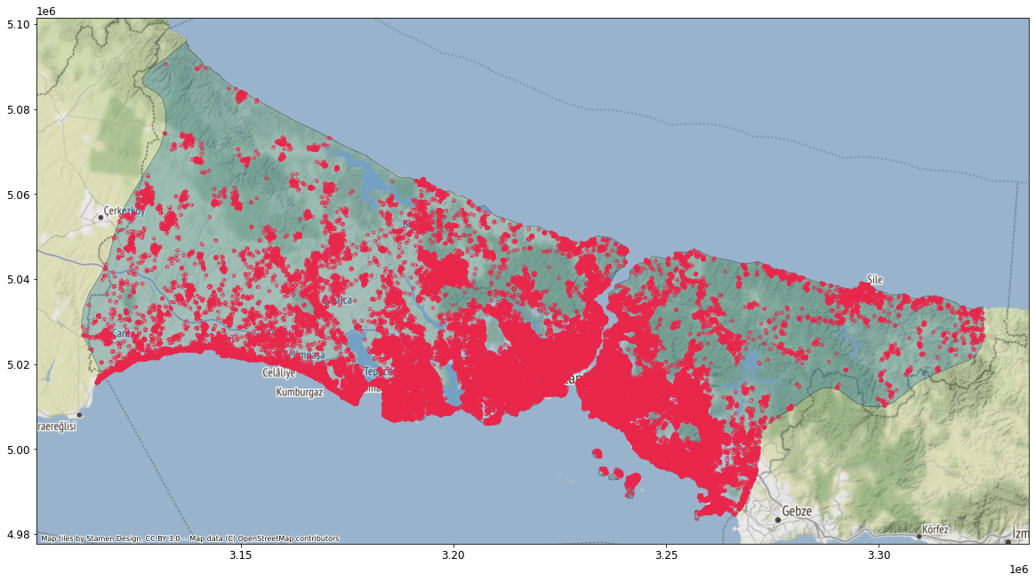
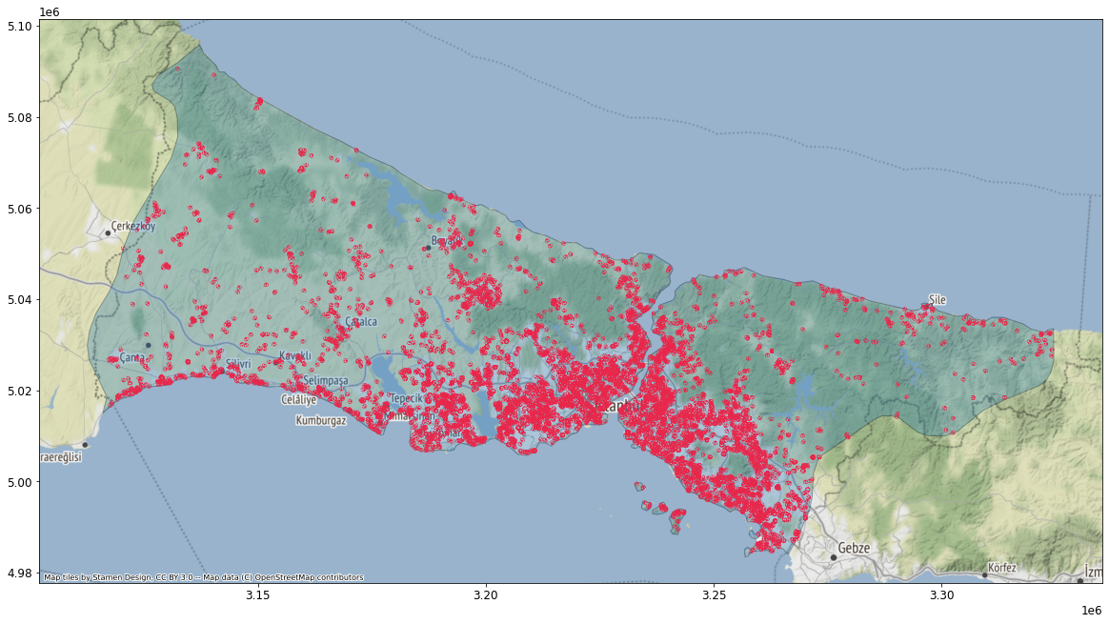
Residential data in İstanbul
867,075 (4.8±0.06%) houses in Istanbul (too many house, I use random samples)
Total area: 29.6 km2 (0.55% of Istanbul area)
Plotting for 4814 houses (0.5% of total houses)
Plotting for 47,719 houses (5.5% of total houses)

Slide 6
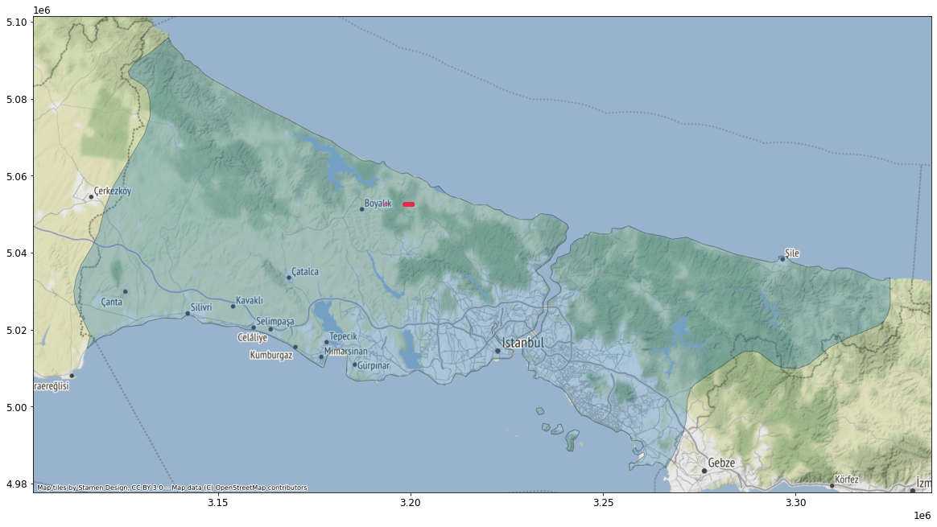
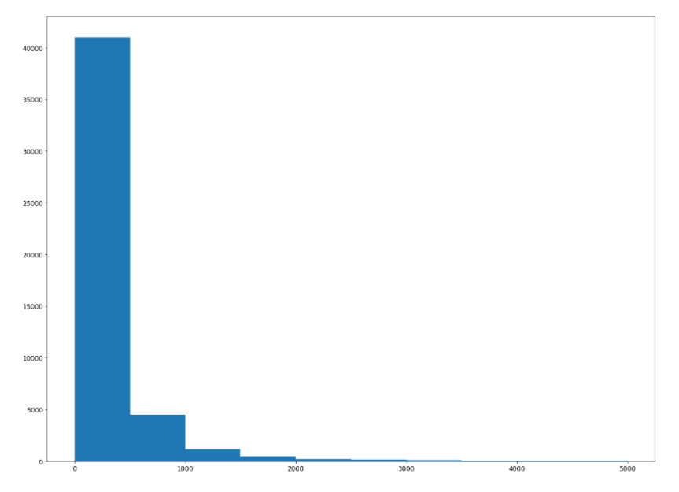
Data cleaning
Largest: 193005 m2
House area (m2)

Slide 7
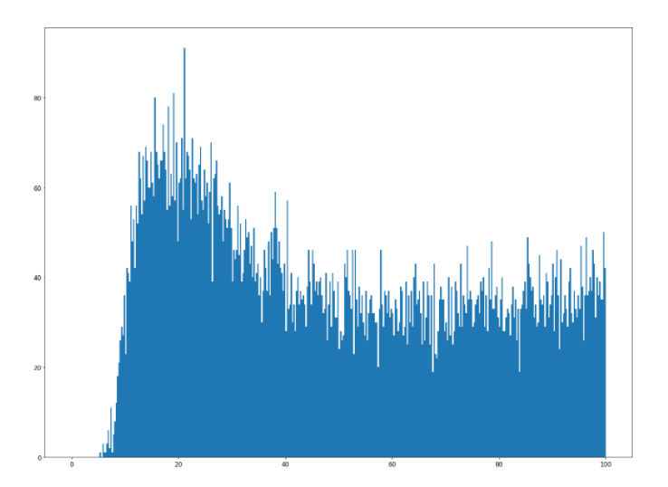
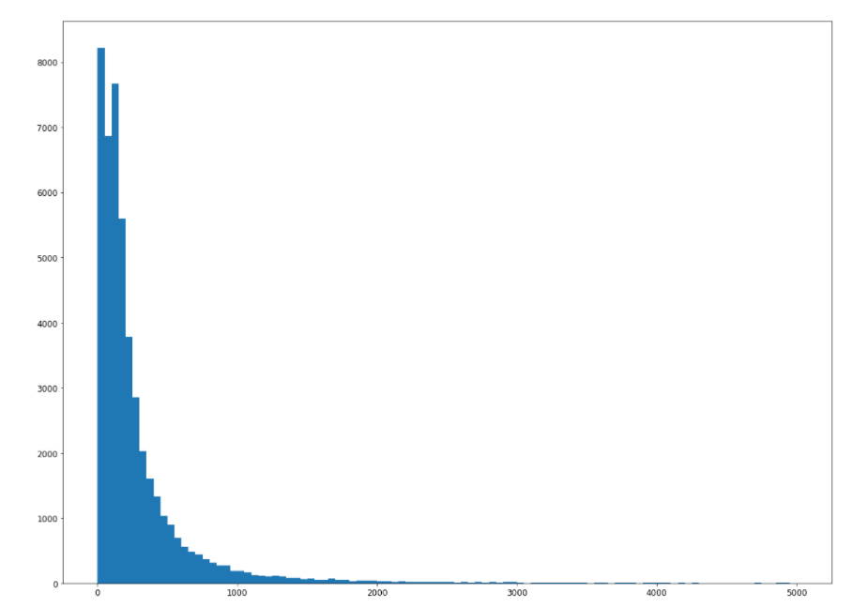
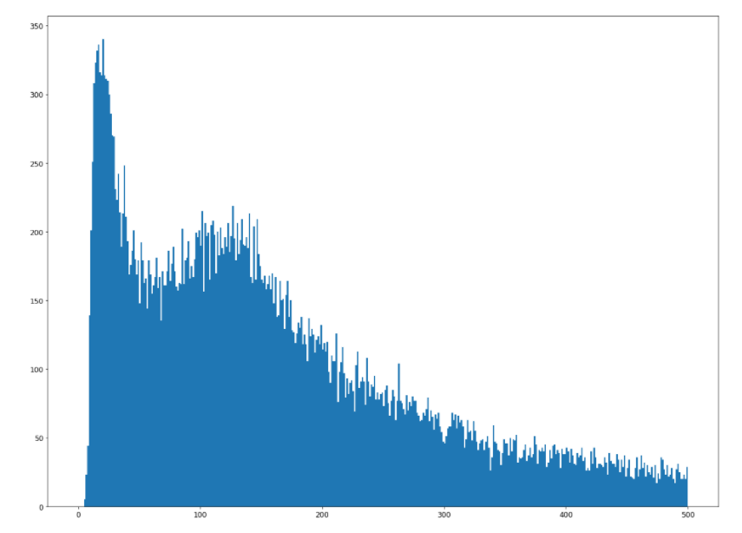
Area < 20m2
100
500
Area too large

Slide 8
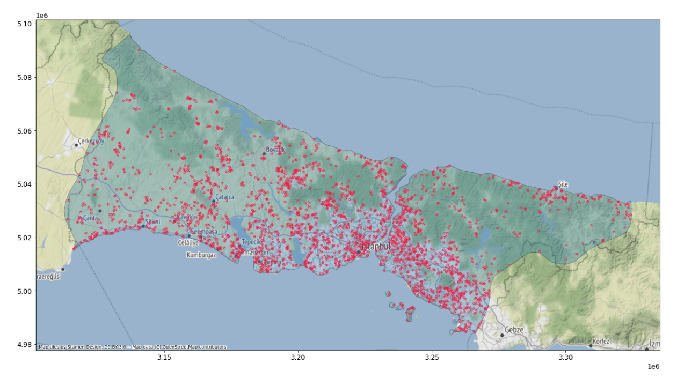
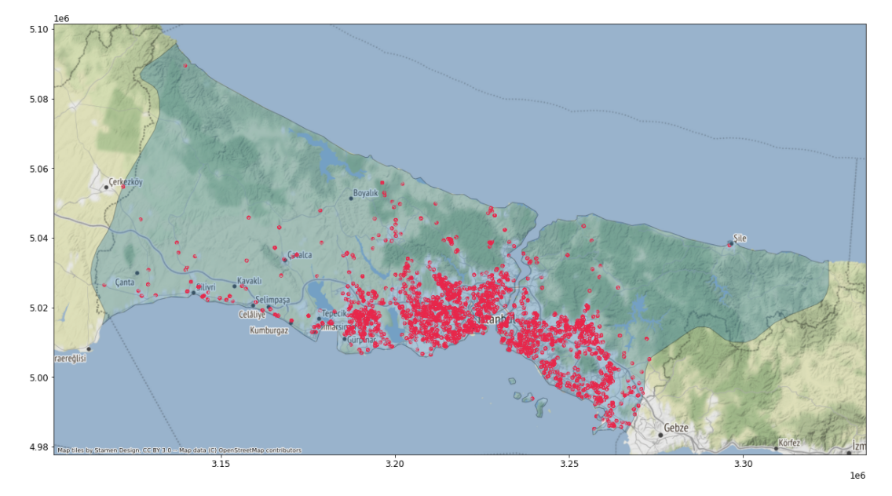
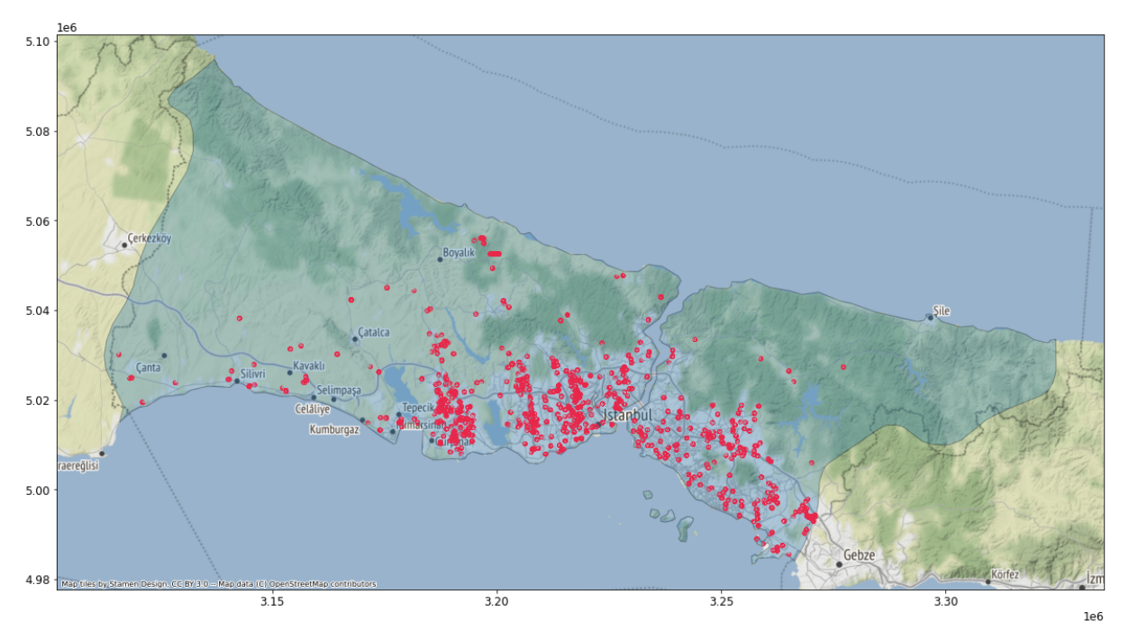
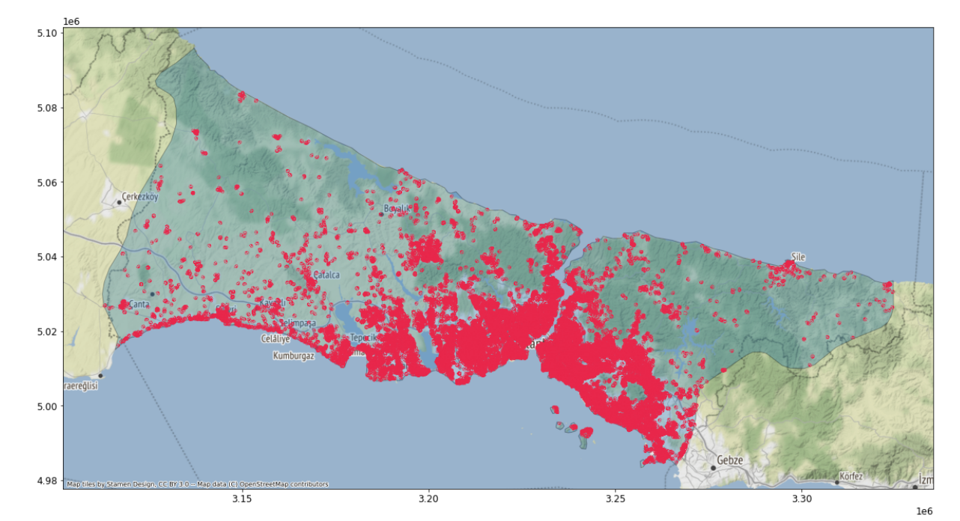
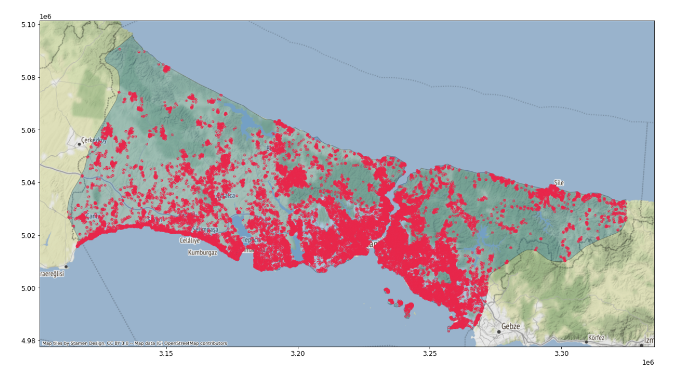
Area < 20 m2 (5.4%)
1000 m2<= Area < 2000 m2 (3.4%)
200 m2<= Area < 1000 m2 (35.8%)
Area >= 2000 m2 (1.3%)
20 m2 <= Area < 200 m2 (53.9%)

